Slide 1

SAB PO
Engineering Dept.

Slide 2
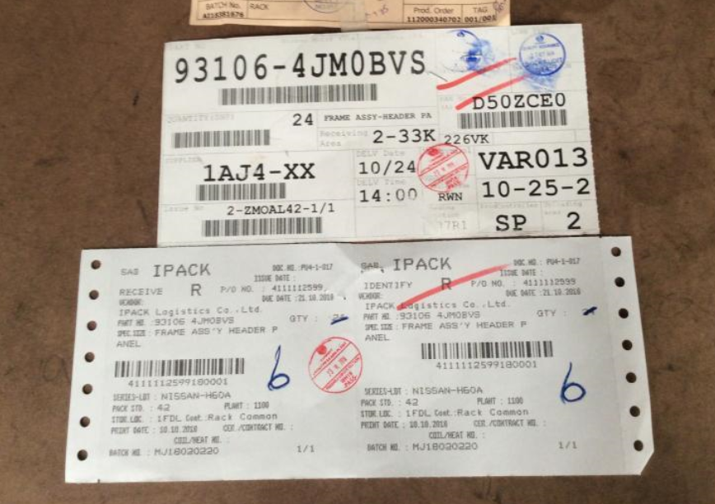
Detail SAB PO
PO Item
4111112599 180 001
PO Number
Running Number of this item

Slide 3
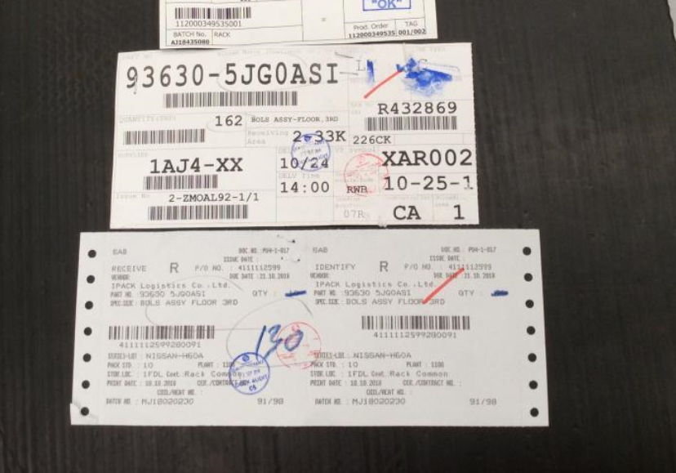
Detail SAB PO
PO Item
4111112599 280 091
PO Number
Running Number of this item

Slide 4


